Slide 1

The Child with a Metabolic Condition
Chapter 31
Niomi Quinteros BSN, RN

Slide 2
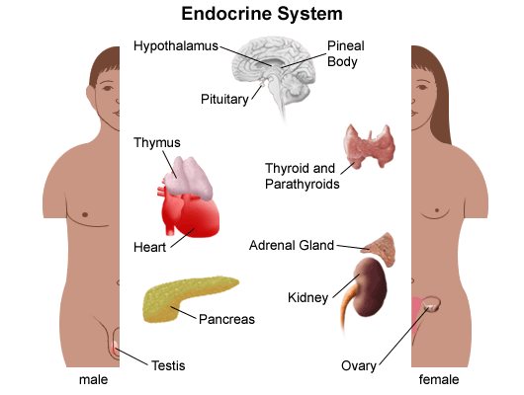
Endocrine System
Two major control systems
Nervous system
Endocrine system
Endocrine
Ductless glands- regulate body’s metabolism
Responsible for:
Growth/maturation
Reproduction
Body’s response to stress

Slide 3
Endocrine System
Early signs of a Metabolic disorder
Lethargy
Failure to thrive
Poor feeding
Enlarged liver
Diagnostic tests
X-ray
Thyroid function
Blood chemistries
Ultrasound/CT scans

Slide 4
Tay-Sachs Disease
Deficiency of lysosomal-beta-hexosaminidase
Manifestations
Slow physical development
Head lag/inability to sit
Cherry red deposits on optic nerve
Blindness
Mental retardation
Treatment and Nursing Care
No cure/no treatment
Palliative care

Slide 5
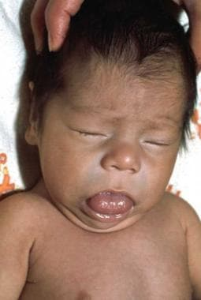
Hypothyroidism
Deficiency of secretions from the thyroid gland
Symptoms
Floppy
Enlarged tongue-noisy respirations
Dry skin
Cold feet/hands
Treatment
Untreated – irreversible mental retardation, physical disabilities
Hormone levels monitored regularly
Thyroid replacement – LIFE LONG
Take medication same time every day
Compliance

Slide 6
Treatment for Hypothyroidism
Signs of too much thyroid replacement
Rapid pulse rate
Dyspnea
Irritability
Weight loss
Sweating
Signs of too little thyroid replacement
Fatigue
Sleepiness
Constipation
Parents should be instructed about both

Slide 7
Diabetes Insipidus
Symptoms
Polyuria
Polydipsia
Weight loss
Craves water
Dry skin
FTT
Dehydration
Drop in BP
Treatment/Nursing care
Hormone replacement
Desmopressin (DDVAP)
Monitor for overdose
Water intoxication
Medical ID bracelet
Limiting access to water—dangerous
Patient/family education

Slide 8
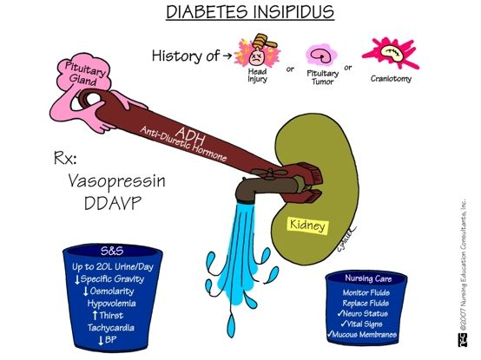

Slide 9
Diabetes Mellitus
Chronic metabolic syndrome
Impairment of glucose transport
Inability to store and use fats properly
2 Types
Type I – Juvenile; insulin-dependent. Destruction of beta cells in pancreas results in lack of insulin production. Autoimmune condition with genetic predisposition for child to get.
Type II – Adult onset; non-insulin-dependent. Resistance to insulin or decreased insulin production, triggered by sedentary lifestyle and obesity.

Slide 10
Diabetes Mellitus (DM)
Long-term complications related to hyperglycemia
Blindness
Circulatory problems, including but not limited to amputation
Kidney disease
Neuropathy

Slide 11
Diagnostic Tests for DM
Random blood glucose
Blood is drawn at any time, no preparation; results should be within normal limits for both diabetic and nondiabetic patients
Fasting blood glucose
If greater than 126 mg/dL on two separate occasions, and the history is positive, patient is considered as having DM and requires treatment
Glycosylated hemoglobin (HbA_{1c}):
Values above 10% indicate poor control
Target should be under 7.5%

Slide 12
Type 1 Diabetes Mellitus
Most common metabolic disorder
Can occur at any time in childhood, new cases highest among
5- and 7-year-olds: Stress of school and increased exposure to infectious diseases may be a triggering factor
11- to 13-year-olds: During puberty, rapid growth, increased emotional stress, and insulin antagonism of sex hormones may be implicated
More difficult to manage in childhood because of growing, energy expenditure, varying nutritional needs
Initial diagnosis may be determined when the child develops ketoacidosis

Slide 13
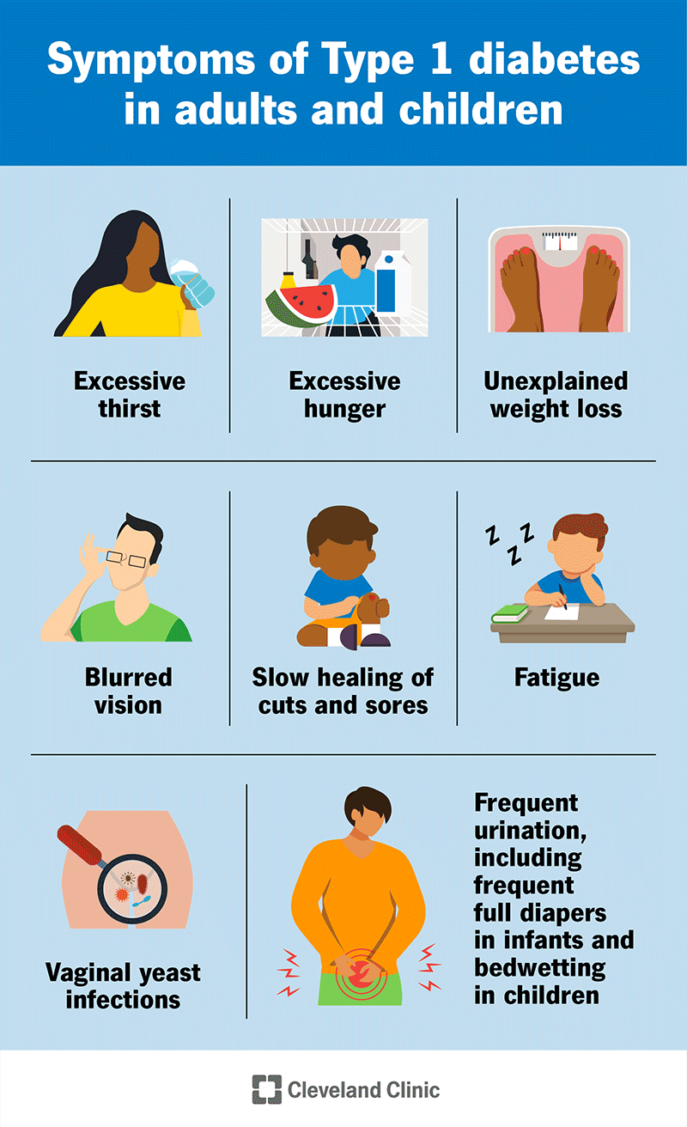

Slide 14
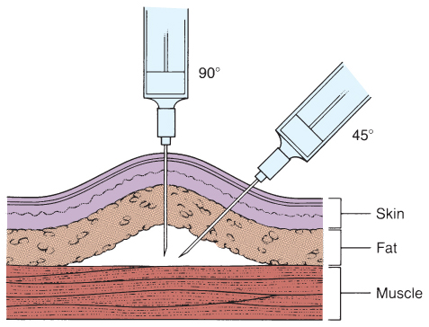
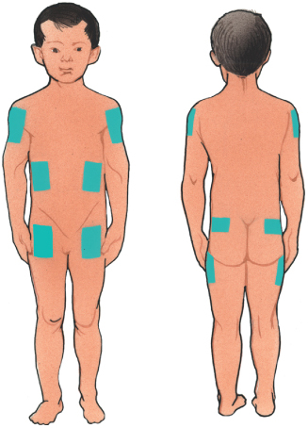
Insulin Administration
Teach parents and child
Insulin cannot be taken orally because it is a protein and would be broken down by the gastric juices
Usual method of administration is subcutaneously
In general, a child can be taught to perform self-injection after 7 years of age
Sites of injections are rotated to prevent poor absorption and injury to tissue
Should not inject into areas that would have a temporarily increased circulation, such as in a child pedaling a bike, you would not inject into the leg
When mixing insulin, always withdraw the regular insulin (clear) first and then add the intermediate-acting insulin (cloudy) into the syringe

Slide 15
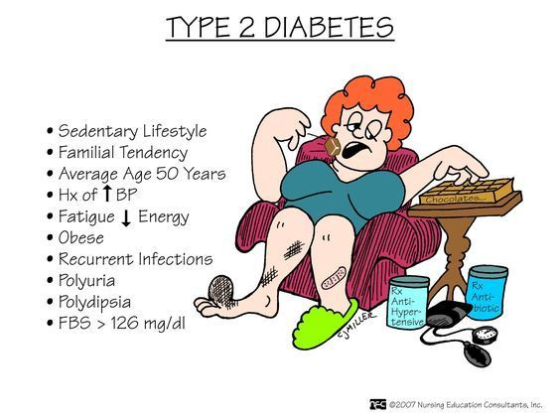

Slide 16
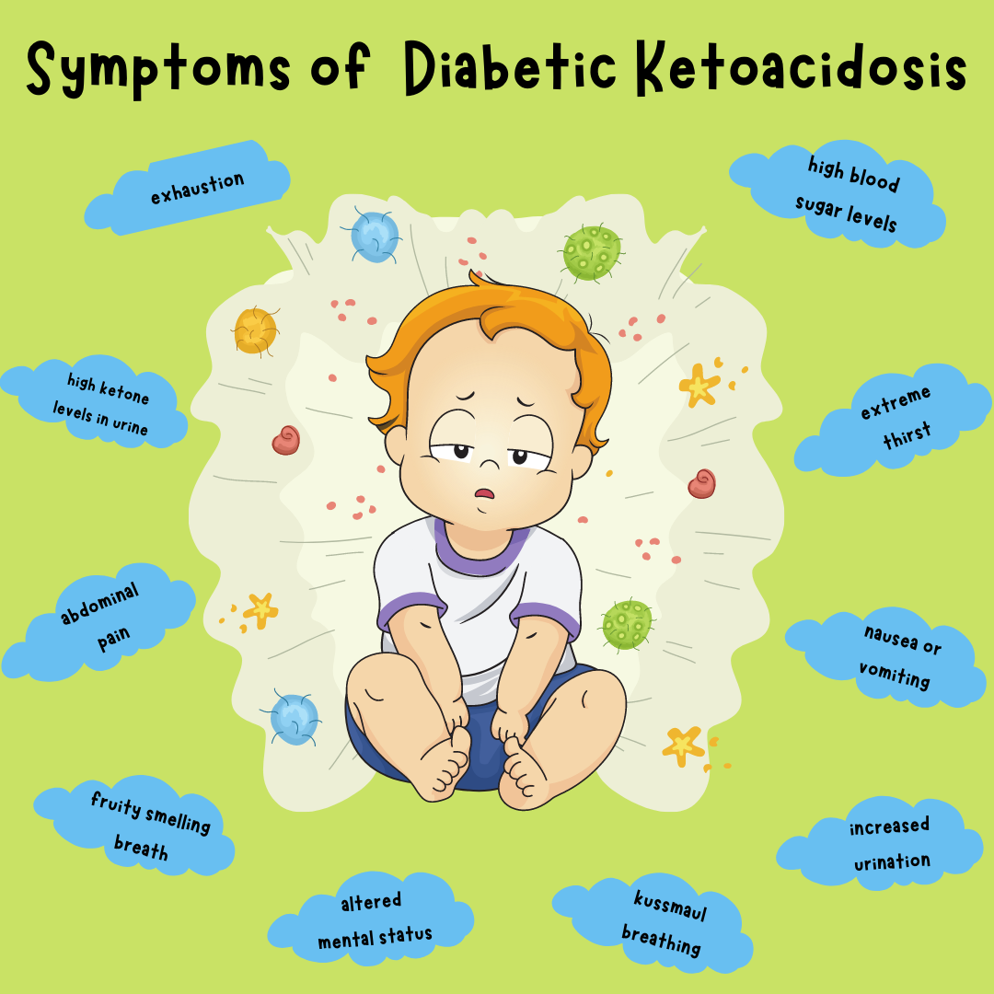

Slide 17
Insulin Shock
Also known as hypoglycemia
Blood glucose level becomes abnormally low
Caused by too much insulin
Factors
Poorly planned exercise
Reduced diet
Errors made because of improper knowledge of insulin and the insulin syringe

Slide 18
Insulin Shock
Children are more prone to insulin reactions than adults because
The condition itself is more unstable in young people
They are growing
Their activities are more irregular
Symptoms of insulin reaction
Irritable
May behave poorly
Pale
May complain of feeling hungry and weak
Sweating occurs
CNS symptoms arise because glucose is vital to proper functioning of nerves

Slide 19
Insulin Shock
Immediate treatment
Administering sugar in some form, such as orange juice, hard candy, or a commercial product
Begins to feel better within a few minutes and then may eat a small amount of protein or starch to prevent another reaction
Glucagon is recommended in cases of severe hypoglycemia

Slide 20
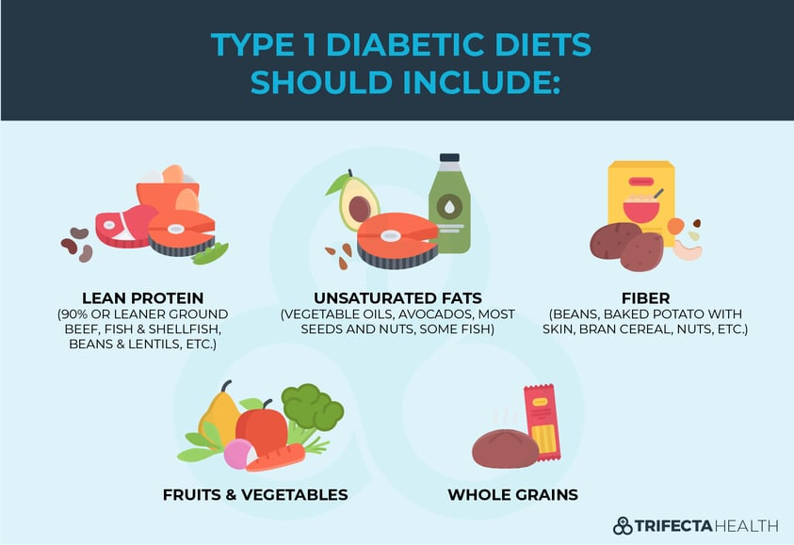

Slide 21
Teaching Plan for a Child with DM
Physiology of the pancreas and its function
Function of insulin
Blood glucose self-monitoring
Diet therapy
Insulin management
Exercise
Skin care
Foot care
Infections
Emotional upsets
Urine check
Glucose-insulin imbalances
Travel
Follow-up care
Illness or surgery

